Slide 1
Engineering Ethics Case Study:
Case 28 | Artificial Intelligence
Team 1
Sebastian Oviedo, Elizabeth McGlone, Anish Goyal, Ariana Story
Notes:
Good afternoon, everyone. Today our team will be presenting an ethics case focused on artificial intelligence, specifically looking at the question of whether society should push forward with AI development or slow down and apply stronger safeguards. Our case is titled ‘Artificial Intelligence: Tap or Slam the Brakes?’ and it examines the ethical responsibilities engineers and technology companies face when powerful technologies are introduced into public spaces, especially law enforcement.

Slide 2

If an AI system is only 60-70% accurate in correctly identifying suspects in an ongoing investigation, should it be allowed to command an arrest or detention?
Notes:
Elizabeth: Before we begin, I want you all to keep this in mind, since it is the main theme of this case study: If an AI system is only 60-70% accurate in correctly identifying suspects in an ongoing investigation, should it be allowed to command an immediate arrest or detention? Would you feel safer or pressured to act in a certain way if you knew that you are being watched, and judged any time you are in public, with a 30% chance that you may be arrested on the spot regardless of your innocence?

Slide 3
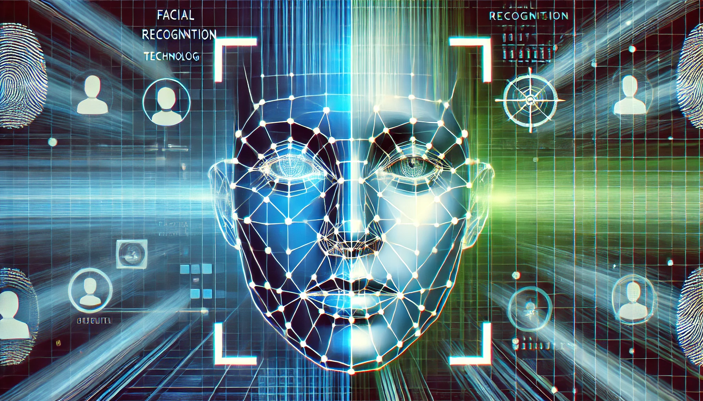
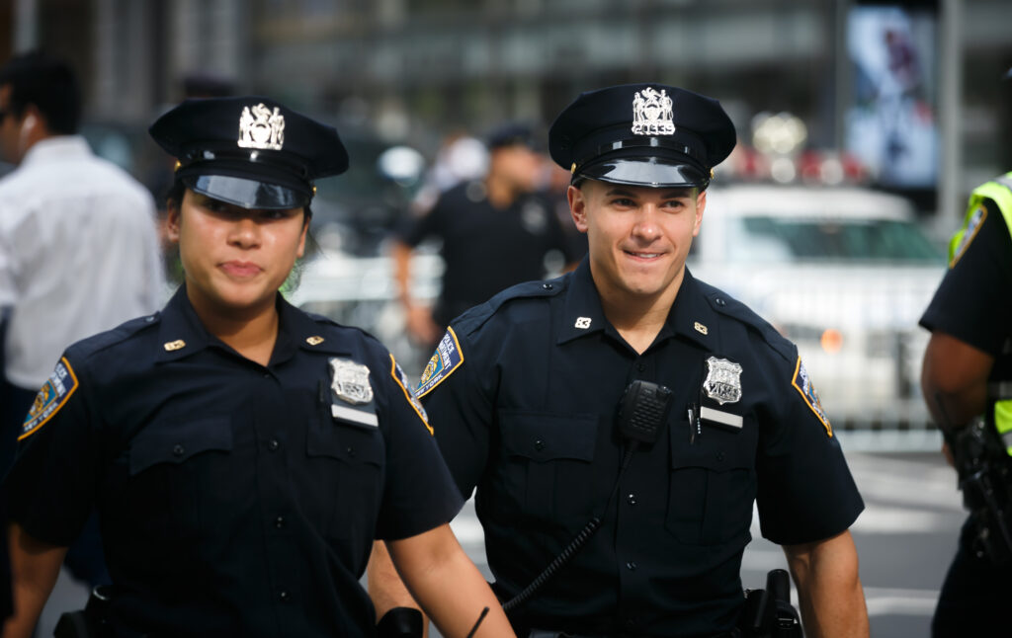
Case Introduction
This case examines the ethical implications of using AI-powered facial recognition technology in law enforcement
Focuses on privacy, accuracy, bias, civil liberties, and public safety
Explores the tension between technological innovation and ethical responsibility
Raises concerns about deploying early-stage AI systems in real-world policing
Notes:
Elizabeth:
This case explores the ethical challenges surrounding the use of AI-powered facial recognition technology by law enforcement agencies. While artificial intelligence has the potential to improve public safety and efficiency, it also introduces serious concerns related to privacy, bias, accuracy, and civil liberties. The case forces us to consider whether deploying AI too quickly—before it is fully tested and regulated—can cause more harm than good, even when the original intention is to protect society..

Slide 4

Case Description
Boundless Brain is a U.S.-based AI startup valued at $25 million
Initially successful using AI to analyze social media for real-time events
Expanded into facial recognition technology using neural networks
Developed face-as-ID security systems
Notes:
Sebastian:
Boundless Brain is a private artificial intelligence startup based in the United States, with a market value of about twenty-five million dollars. The company first gained commercial success by using AI to analyze social media platforms and identify real-time events and situations. In other words, their AI is effective in delivering an answer quickly, so their priority is speed. This early success encouraged the company to expand into more advanced applications of artificial intelligence. One of their major developments was facial recognition technology built using neural networks and complex algorithms, which allowed individuals to be identified through their facial features. This technology positioned Boundless Brain as a pioneer in face-based identification systems, meaning that they are at the forefront of the technology and all other competition would aim to deliver similar products.

Slide 5
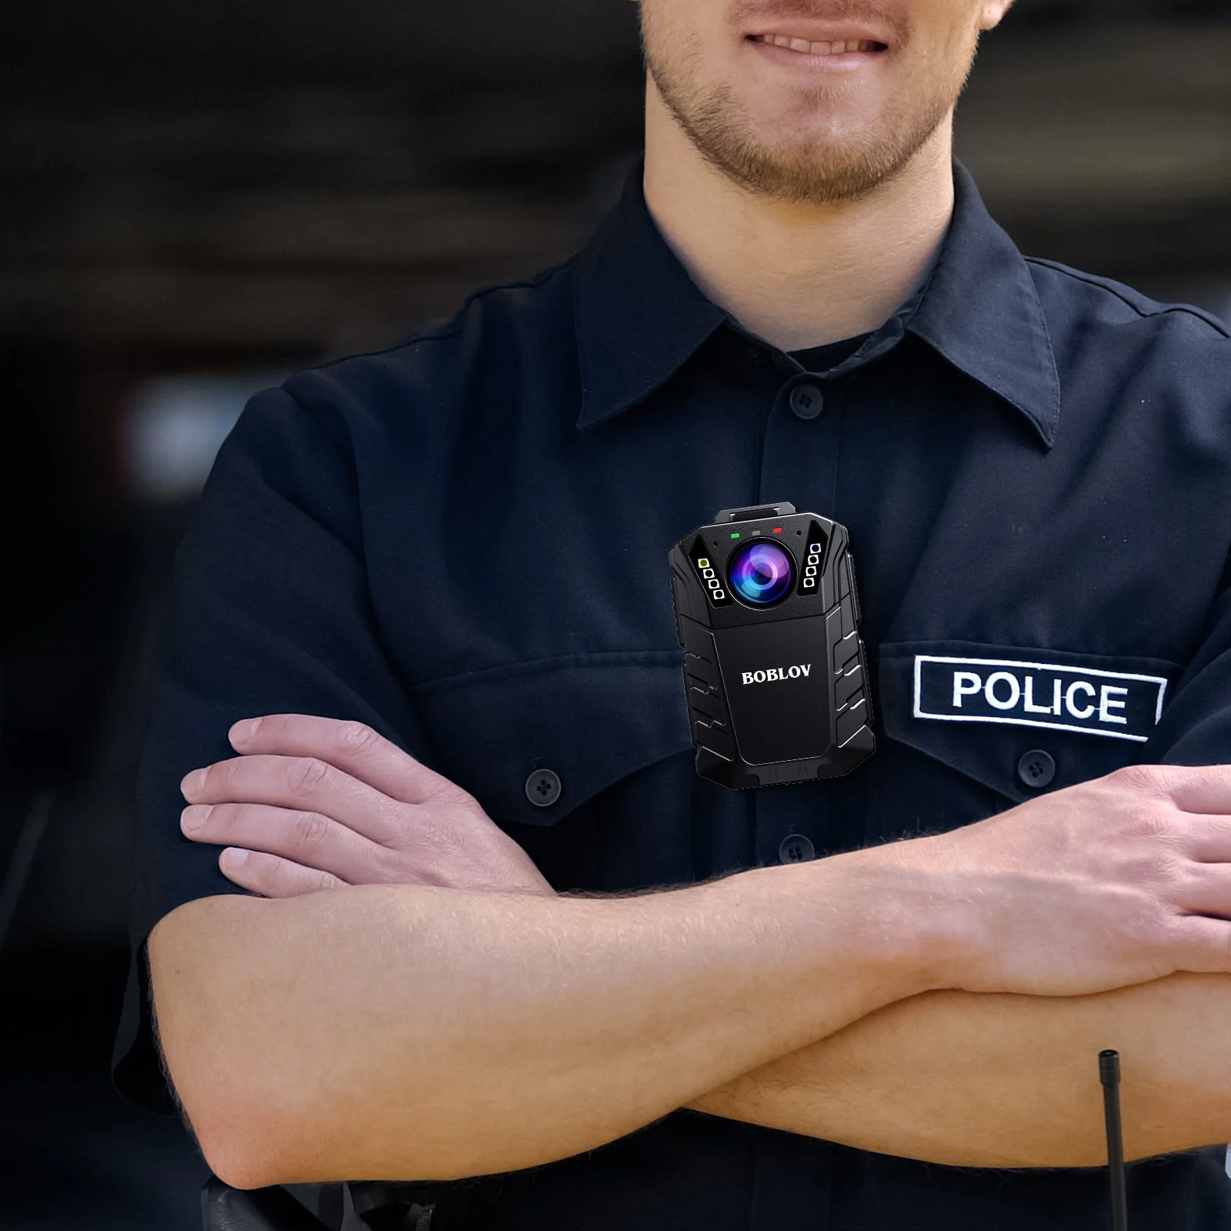
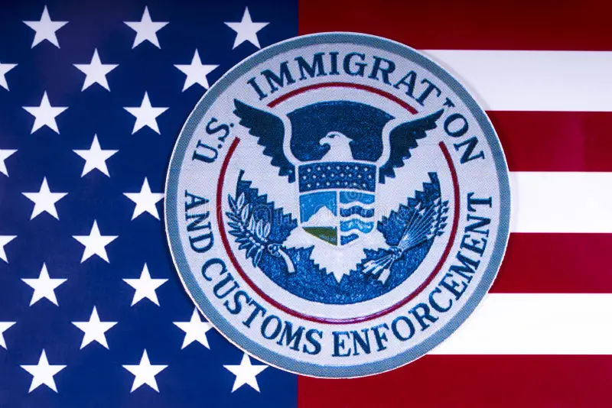
Case Description
Company now integrating AI into police body cameras and video surveillance
Technology identifies suspects in real time, not after crimes
Interest shown by:
Local police departments
U.S. Immigration and Customs Enforcement (ICE)
Facial recognition system has a 35% error rate
Employees raised ethical concerns and some refused to work on AI drones
Notes:
Sebastian:
As the company continued to grow, Boundless Brain began integrating its facial recognition technology into police body cameras and video surveillance equipment. Now, unlike traditional facial recognition, which is often used after a crime has occurred, this system identifies individuals in real time, therefore being able to influence what happens at the moment of recognition. This capability quickly attracted interest from multiple police departments and even federal agencies such as U.S. Immigration and Customs Enforcement. However, the technology is still in its early stages and has an error rate of approximately thirty-five percent, which raised serious concerns among employees, as a 35% error rate also means that one in three people would be falsely identified as a criminal, with what happening next depending solely on how law enforcement chooses to act. Some employees refused to work on certain projects, fearing that the technology could be misused, target innocent individuals, or disproportionately harm marginalized communities. Now that we understand what the system is, where its being used, and what is at stake, we can look at the ethical concerns.

Slide 6

Main Issues Related to Ethics
Use of unproven AI technology in high-risk law enforcement settings
Violation of privacy and civil liberties
Bias and discrimination, especially against marginalized groups
Lack of transparency and accountability in AI algorithms
Conflict between innovation vs. regulation
Notes:
Ariana:
What we are considering to be the major ethical issue in this case is the accuracy and reliability of the data provided by this hypothetical model. We know that this AI is in its early stages, and has not been fully validated. Deploying AI with known flaws in law enforcement settings introduces risks to individual rights and public trust. An innocent person can be detained, questioned, or arrested when they did nothing wrong; in other words, we are concerned that this technology’s errors could translate into harm. It’s not a superficial case about an inaccurate AI, but there are also concerns about misuse, lack of transparency, racial bias, and the possibility that innocent individuals could be harmed due to system errors. At the heart of the issue is a conflict between rapid technological innovation and the ethical obligation to protect the public.

Slide 7
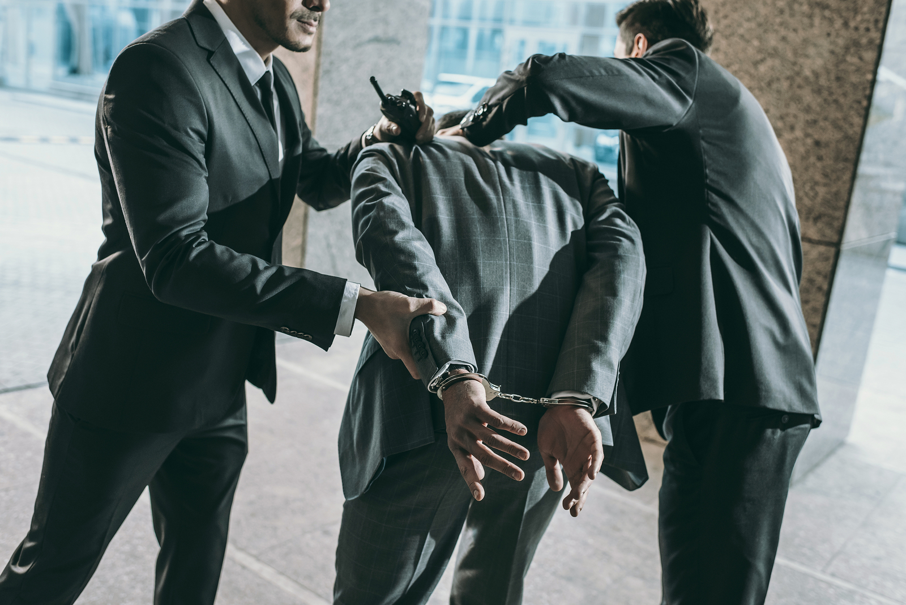

What are the ethical issues?
Deployment of facial recognition with high error rates
Potential misidentification leading to wrongful arrests
Surveillance of lawful protesters
Racial and gender bias in AI decision-making
Insufficient safeguards for data security and misuse
Absence of clear government oversight
Notes:
Ariana:
The primary ethical issues involve the reliability and fairness of the facial recognition software. With an error rate of approximately thirty-five percent, the system is prone to misidentifying individuals. This raises serious concerns about wrongful detentions, arrests, or increased surveillance of innocent people. There are also privacy concerns related to constant monitoring in public spaces, as well as security risks involving how biometric data is stored and used. These issues are especially troubling when the technology is applied without clear limits or oversight.

Slide 8
Who is involved?
Boundless Brain executives:
CEO (supports expansion)
CIO (anti-regulation)
CLO (supports regulation)
Board of Directors
Boundless Brain employees
Law enforcement agencies
Government agencies (ICE)
General public
Marginalized communities (especially people of color)
Civil liberties organizations
Notes:
Anish:
Several groups are affected by this situation. Within Boundless Brain, executives, board members, and employees all play key roles in decision-making. Some employees have openly resisted working on certain AI projects due to ethical concerns. Externally, law enforcement agencies and government bodies like ICE are major stakeholders. Most importantly, the general public—and particularly marginalized communities—are directly impacted, as they are the ones being monitored and potentially misidentified by the technology.

Slide 9

Where is this taking place?
United States
Police departments using body cameras
Public spaces (protests, borders, streets)
U.S.–Mexico border surveillance
Government and law enforcement environments
Notes:
Anish:
These ethical issues take place primarily in the United States, in public environments such as streets, borders, protests, and community spaces where police body cameras and surveillance systems are used. The technology is also intended for use along the U.S.–Mexico border, which adds another layer of ethical concern related to immigration enforcement and vulnerable populations.

Slide 10
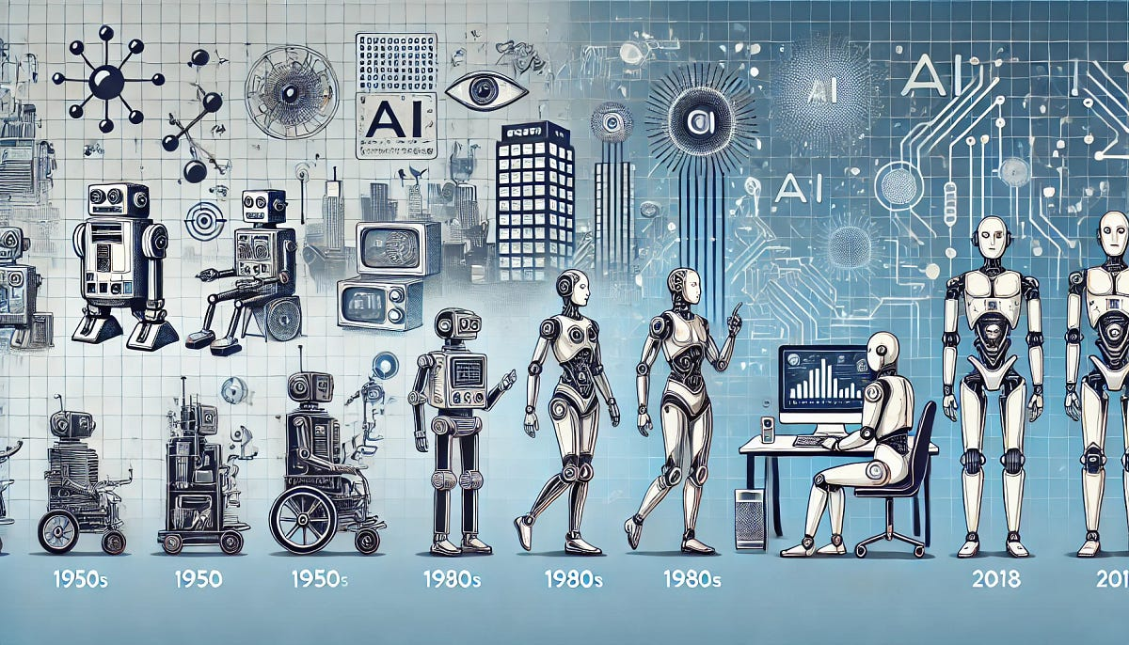
When do ethical issues occur?
During early-stage development of AI facial recognition
Before sufficient testing and validation
When law enforcement agencies seek rapid adoption
During increased public scrutiny of surveillance technologies
Notes:
Anish:
The ethical issues occur during the early development and deployment phase of the technology—before sufficient testing, regulation, or accuracy improvements have been made. This timing is critical because once the technology is deployed, its impact on citizens is immediate, and mistakes can have serious real-world consequences.

Slide 11
Why do the ethical issues occur?
Pressure to capitalize on the rapid growth of AI markets
Financial incentives and venture funding
Belief that AI can:
Reduce crime
Improve border security
Prevent terrorism
Lack of enforced regulations governing AI deployment
Desire for competitive advantage over other AI firms
Notes:
Anish:
These ethical issues exist largely due to economic pressure and competition in the AI industry. Boundless Brain wants to capitalize on the rapid growth of artificial intelligence and secure lucrative contracts with law enforcement agencies. There is also a belief among company leadership that the potential benefits, such as reducing crime or improving security, outweigh the risks. However, the lack of clear regulations allows these decisions to be made without sufficient ethical safeguards.

Slide 12
How can these issues be addressed?
Implement strict government regulations for AI surveillance
Require minimum accuracy thresholds before deployment
Conduct independent bias and performance audits
Increase transparency of AI algorithms
Limit AI use to post-incident analysis, not real-time identification
Establish clear accountability for misuse or errors
Notes:
Anish:
These ethical challenges can be addressed through a combination of regulation, accountability, and technical improvements. Governments should establish clear rules for how AI surveillance technologies can be used. Independent audits should be required to assess bias and accuracy. Transparency about how algorithms function is essential, and the technology should not be deployed in real time until it meets strict accuracy standards. These steps help ensure that innovation does not come at the cost of civil rights.

Slide 13
IEEE Codes Violated
IEEE Code Number & Brief Description* | Reason
Code 1 & 9: Prevent and disclose potential public endangerment, avoid if possible by false or malicious action. | Failure to protect public safety due to high error rate
Code 3: To be honest and realistic claims based on available data | Lack of honesty about AI limitations
Code 5: Improve the understanding of technology | Inadequate discussion and consideration of societal consequences by leadership
* See [1] for full description of IEEE code of ethics.
Notes:
Sebastian:
In this case, several specific IEEE Codes of Ethics are violated or placed at serious risk.
First, IEEE Code 1 and Code 9 are violated, which requires engineers to prioritize the safety, health, and welfare of the public as well as avoid injuring others, their reputation or employment. We merged these two under the same discussion as it involves the same major problem: Deploying facial recognition technology with a thirty-five percent error rate in real-time law enforcement scenarios puts innocent people immediately at risk of being misidentified, detained, or surveilled without cause. Compliance with this would be restricting the AI for only post-investigative use or until its proven to be safe for real-time use, as relying on AI for probable cause is unreasonable, corroboration is a must.
Second, IEEE Code 3, which emphasizes honesty and realism in stating technical limitations, is also violated. While Boundless Brain promotes the potential benefits of their technology’s applications, it shows how internally they show little concern about the technology’s readiness and potential consequences. Leadership actively pushes to sell a product that is defective, at least a third of the time, to government agencies that potentially aim to overtrust the outputs of the model. Compliance with the code would involve leadership disclosing limitations, and simply recognizing that the model is not ready for real-time decision making, making it clear to contracting agencies to not immediately take the model’s outputs as probable cause.
Third, IEEE Code 5 is violated because the company does not adequately address the broader societal consequences of its technology. The leadership focuses on crime reduction and efficiency, but fails to fully consider the long-term impacts on privacy, civil liberties, and public trust. Compliance with these codes would be the establishment of a Human Factors department with certain authority in the company, that is in charge of documenting and assessing the model’s performance and long-term impacts on public applications of the AI

Slide 14
IEEE Codes Violated
IEEE Code Number & Brief Description* | Reason
Code 7: Seek, accept, offer honest criticism of technical work, acknowledge and correct errors | Ignoring employee’s unrest and criticism about the proposed technology
Code 8: Treat all persons fairly, regardless of race, ethnicity, gender, etc. | Discriminatory impact on marginalized communities
Overall, the IEEE codes violated point to leadership treating this as routine software rollout rather than a significant and potentially defective paradigm shift in how law enforcement is conducted.
* See [1] for full description of IEEE code of ethics.
Notes:
Sebastian
IEEE Code 7 requires seeking and accepting criticism, which is also relevant, as employee concerns and internal criticism were raised but not meaningfully addressed by leadership and are instead minimized.
Finally, IEEE Code 8, which requires fair treatment of all individuals regardless of race or gender, is clearly violated due to the system’s higher error rates for darker-skinned women and marginalized groups. This creates discriminatory outcomes that conflict directly with ethical engineering standards.”
To summarize our assessment on the IEEE codes violated, is that the identified violations along with their root causes point at a leadership that refuses feedback, and instead is pushing a defective technology that has the potential to affect the liberty and safety of the general public. Ethical engineering requires validation, transparency, and safety before real-time deployment.

Slide 15


Real-World Parallel: Palantir
Company that builds software that enable government agencies to visualize and analyze massive datasets
Recent concerns raised about Palantir’s partnerships with DHS and ICE. [2] [3]
In 2017, Palantir technology was used by ICE to arrest parents and caregivers of unaccompanied children, harming children’s welfare [4]
Notes:
Sebastian: A real world example that has some parallels with this case study is Palantir Technologies and their partnership with US Government agencies, including DHS components like ICE. Palantir is a company that, in short terms, develops software that enables governments or contractors to process massive amounts of data used in law enforcement or security applications.
In the immigration context, several reports and investigations raised concerns that these kinds of tools increases the ability for the government to identify, track, and act on individuals quickly, which leaves room for error or weak oversight. While the current accuracy and leverage that Palantir’s software has over recent events is still debatable, a historical case from is their involvement in conducting arrests of sponsors of unaccompanied children. We connect this to IEEE codes 1 and 9, because surveillance and identification tools have been deployed in a setting that can expose vulnerable populations to harm.

Slide 16
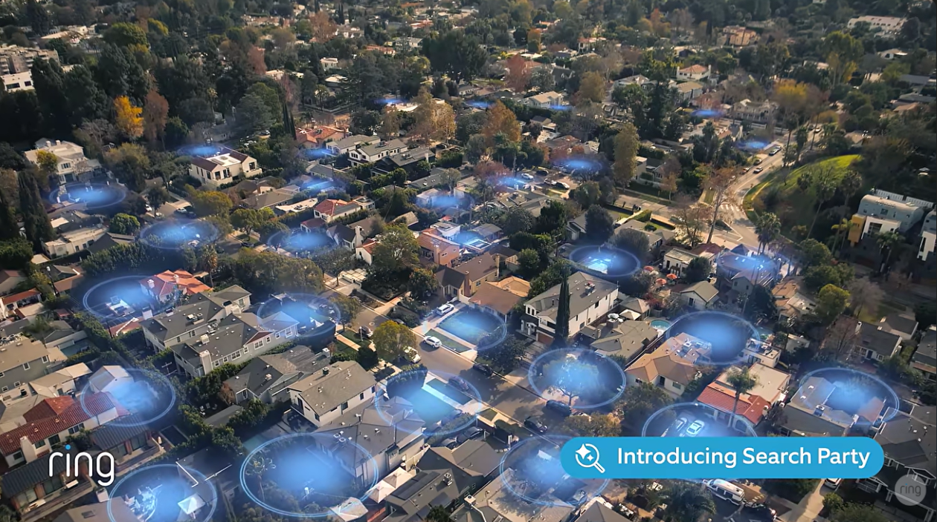

Real-World Parallel: Ring Search Party
Ring is an Amazon-owned company that makes hardware and software for smart home security.
In 2026, they announced a partnership with Flock Security to develop “Search Party”
In 2023, Ring employees allegedly surveilled customers, sparking mistrust [5]
Notes:
Another real world parallel to this case study is the ring doorbell search party program. Ring describes search party as a system that networks all opting ring cameras and uses AI to help find lost dogs. On paper, its a community safety feature, but its a stepping stone that can be easily expanded or abused in the scope of surveillance. A networked neighborhood security camera system can create public fear that it will be adapted to track other things later down the line. Especially when one considers that in 2023, the FTC alleged that Ring employees and contractors had too much access to customer videos, exposing the private lives and routines of customers to potential security threats. We connect this to IEEE codes 3, 5, and 6. As Ring has a history of dishonesty regarding its access to customer videos, and the potential consequences of implementing an AI tool that can be easily abused without proper safeguards. As of last week, the search party program has been canceled.

Slide 17
Original Solution to the Case
Company leadership favored continued development and deployment
CIO argued against regulation to avoid slowing innovation
BoD believed benefits outweighed ethical risks
No clear safeguards or accuracy improvements before rollout
Relied on law enforcement discretion rather than ethical controls
Notes:
Ariana:
The original approach taken by Boundless Brain leadership was to continue developing and deploying the technology with minimal restrictions. The Chief Innovation Officer argued that regulation would slow progress and increase costs. The Board of Directors believed the benefits to law enforcement and national security justified the risks. However, this solution largely ignored the concerns raised by employees and civil liberties advocates.

Slide 18
Team’s Proposed Solution
Pause real-time deployment until accuracy exceeds 95%
Mandatory third-party audits for bias and fairness
Clear federal regulations for AI surveillance use
Restrict use to serious crimes only
Require warrants and transparency reports
Create ethics review boards within AI companies
Ongoing monitoring and public accountability
Notes:
Ariana:
Our team proposes a more ethically responsible solution. Deployment of real-time facial recognition should be paused until the technology reaches a much higher accuracy level. Independent audits should be mandatory, and clear regulations must govern how and when AI surveillance is used. We also believe usage should be limited to serious crimes and require warrants. These measures allow AI to benefit society while minimizing harm and protecting constitutional rights.

Slide 19

Discussion
Should AI be allowed in policing before it is fully accurate?
Can public safety benefits justify privacy trade-offs?
Who should regulate AI: companies or governments?
Notes:
Elizabeth: At this point, we’d like to open the discussion to the audience. Should AI be allowed in law enforcement before it is highly accurate? Do the potential benefits outweigh the risks to privacy and civil liberties? And who should ultimately be responsible for regulating these technologies—governments, companies, or both? These are questions that engineers and policymakers will continue to face as AI becomes more powerful.

Slide 20
Conclusions
AI facial recognition presents serious ethical risks
High error rates make real-time deployment dangerous
Marginalized communities face disproportionate harm
IEEE ethical principles require safety, fairness, and transparency
Responsible innovation must balance:
Public safety
Civil liberties
Ethical engineering practices
Notes:
Elizabeth:
In conclusion, while artificial intelligence offers powerful tools for improving public safety, it also introduces serious ethical risks when deployed without sufficient safeguards. The Boundless Brain case shows how high error rates, bias, and lack of transparency can threaten individual rights. By following IEEE ethical principles, engineers can help ensure that innovation serves society responsibly. Ethical AI development requires balancing progress with accountability, fairness, and respect for human rights.

Slide 21

Questions?

Slide 22
References
[1] IEEE Code of Ethics, https://www.ieee.org/about/corporate/governance/p7-8
[2] ICE to use immigrationsOS by Palantir, https://www.americanimmigrationcouncil.org/blog/ice-immigrationos-palantir-ai-track-immigrants/
[3] Documents offer insights on ICE-Palantir relationship, https://www.theguardian.com/us-news/ng-interactive/2025/sep/22/ice-palantir-data
[4] Palantir Technologies Contracts Raise Human Rights Concerns, https://www.amnestyusa.org/press-releases/palantirs-contracts-with-ice-raise-human-rights-concerns-around-direct-listing/
[5] FTC Says Ring Employees Illegally Surveilled Customers, https://www.ftc.gov/news-events/news/press-releases/2023/05/ftc-says-ring-employees-illegally-surveilled-customers-failed-stop-hackers-taking-control-users

